Slide 1
Memories and Emotional Travel
Kendall Costello, Tina Jiang, Andrea Shulman, Steve Weyns
Notes:
Memory formation
Change in memory over time
Memory record
Relationship bw memory and emotion

Slide 2

Needfinding
Methodology
Notes:
We will first take you through our..
We interviewed four people total
<super fast>

Slide 3
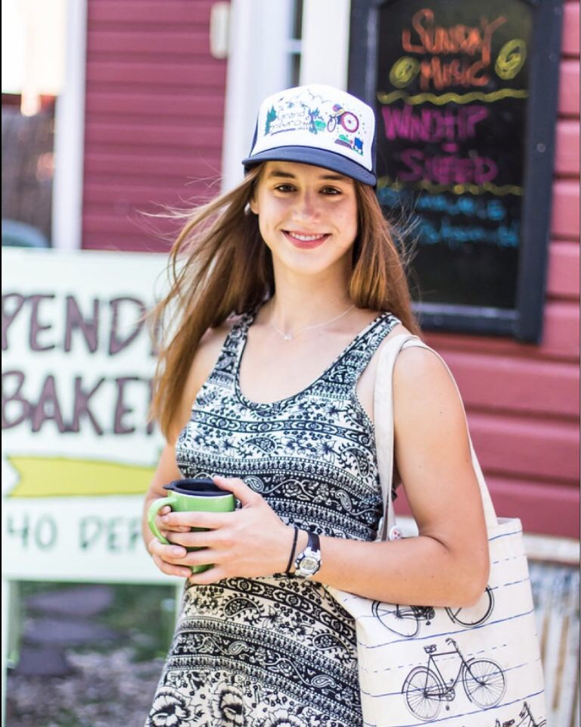
Ellie Dunn
Stanford freshman
“I try to capture the feeling of happy moments through haikus.”
Notes:
emotive - interesting perspective
In her dorm

Slide 4
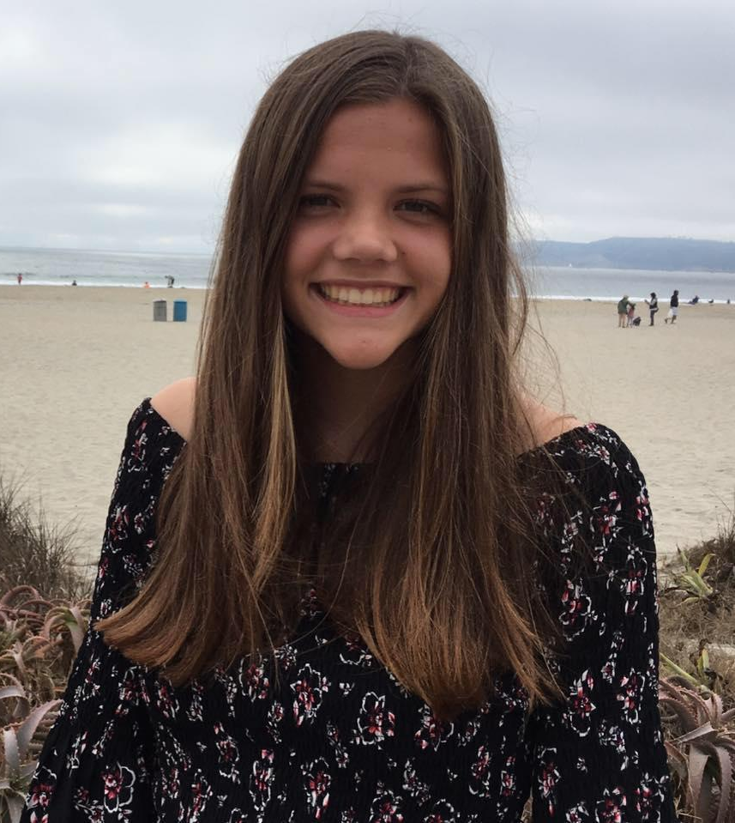
Jenna Reed
High school student
“Some of my memories exist solely because others told me about them.”
Notes:
Menlo Atherton
younger perspective
introspective individual
Interviewed at Pete’s coffee

Slide 5
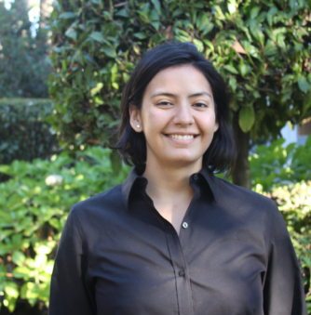
Gabriela Quintana
A local tourist
“I feel comfortable with not fully remembering because I think memory is malleable.”
Notes:
Works to facilitate academic scholarships
Why - tourist, we wanted an adult
Touring stanford outside the visitor center

Slide 6
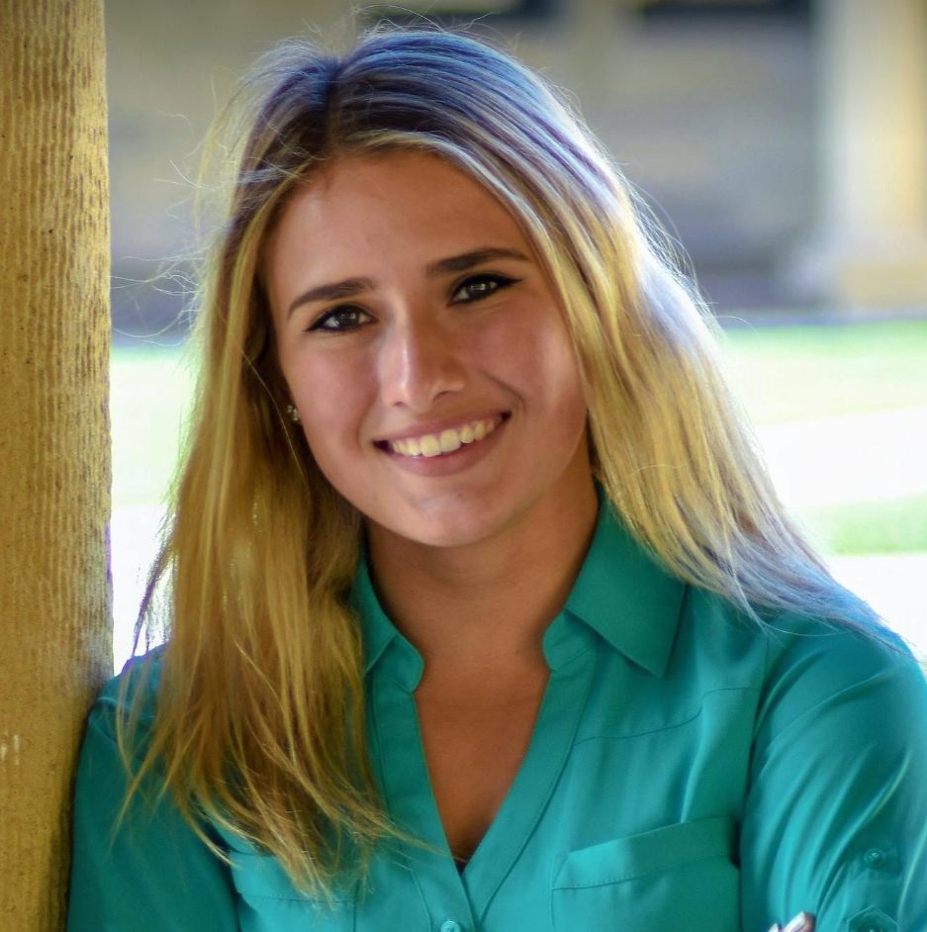
Kasia Kowalski
Amateur YouTuber;
Stanford Student
“I record when my hands are free, it’s a wholesome moment, and it’s not something that happens everyday.”
Notes:
Extreme user - blogger and makes montages -
lots of focus on life documentation
Recommendation from a mutual friend
In her dorm room

Slide 7

Tell me about your happiest moment.
What was going through your head at the time?
Can you tell me about a time you felt negative emotions?
Is this memory still relevant for you?
What do you do if you can’t remember memories?
How are things different in your life this year?
Do you have any ways to recount the emotional changes in your life?
What places/times trigger memories?
Notes:
Through emotional journey through time
The process of recall
happiest moment
- what do you do if you can’t rememeber
- are these memories still relevant

Slide 8
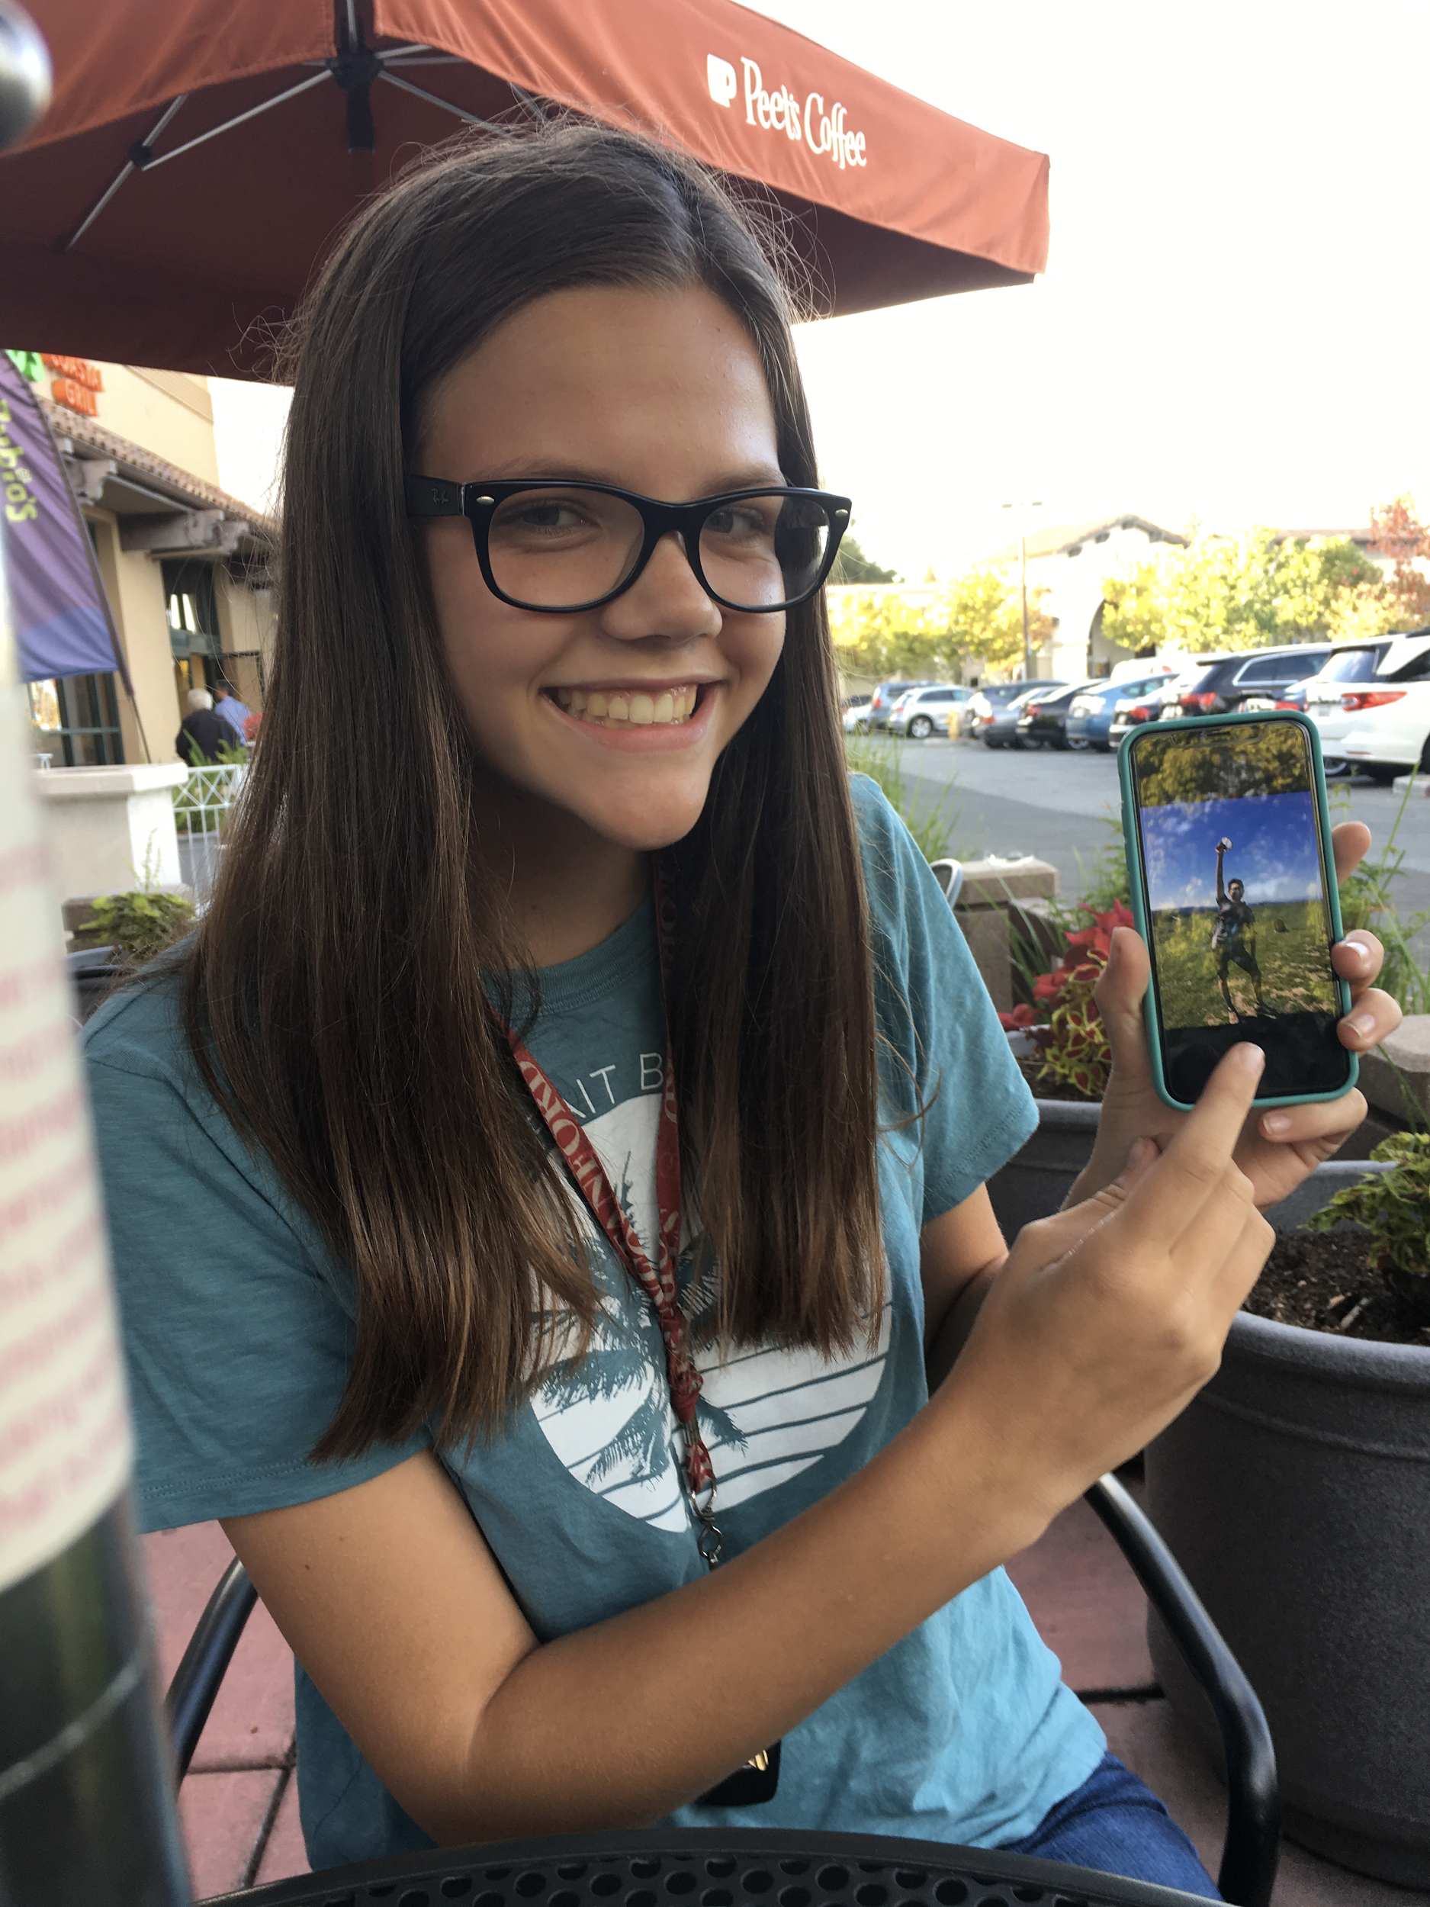
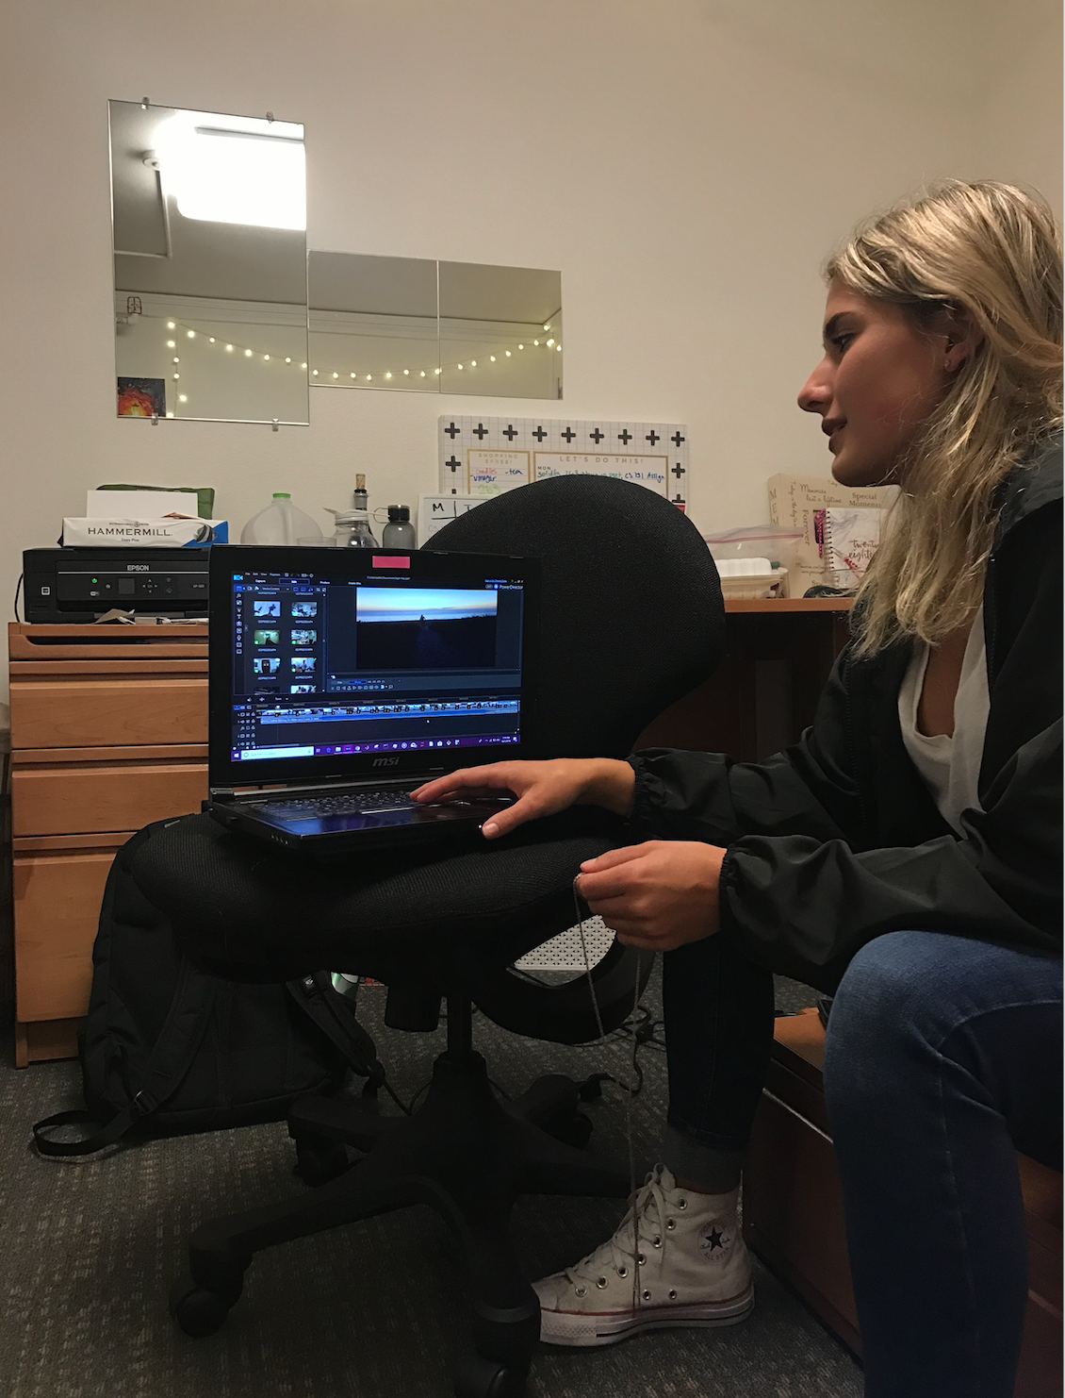
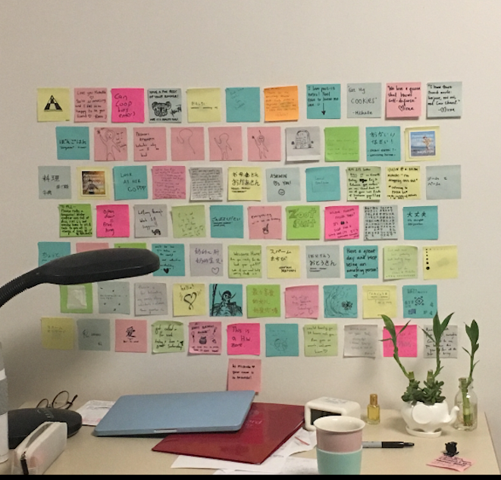
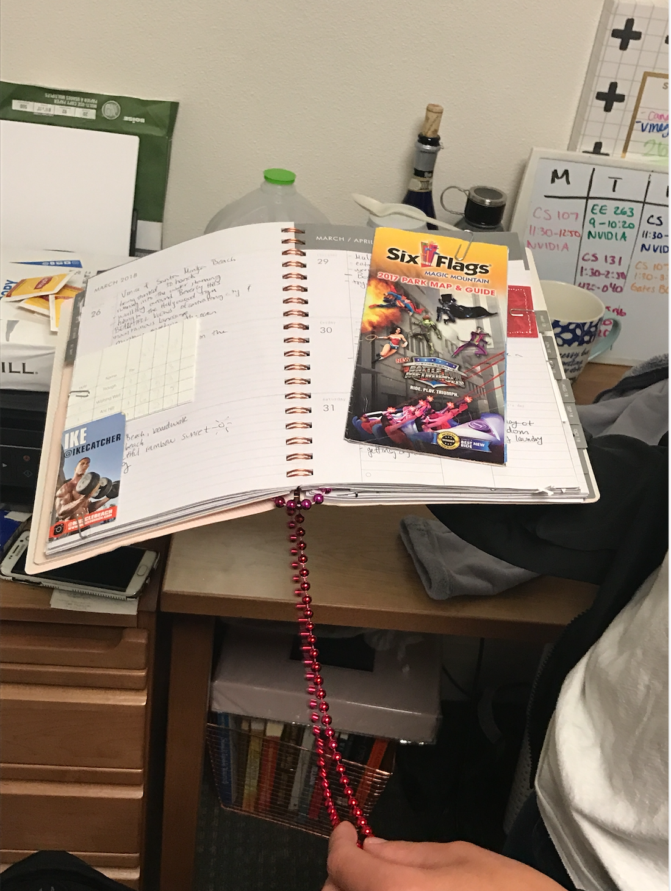
Notes:
Here are some photos we took while interviewing people
Walk through process she goes through to create a montage
We observed her working on her next montage, apprentice and craftsman model
Jenna pointing to a photo of her hiking trip
Journal - records 2-5 notable positive things a day, and any tangible keepsakes
Each note encapsulates a story or past experience / feeling, keeping from the past 2 to 3 years that stick , literally for her to put them up
Images or words

Slide 9

TENSIONS
Recall ranges from generic to specific
Stepping out versus immersing fully
Perception of memories are malleable
Notes:
We noticed tensions where people thought about things in conflicting ways
People remember things in general -> specific (more common for broad events) spec->gen tip of the tongue searching for a part of an event to try to recall the whole event
Super happy moment, almost out of body experience whereas others focused on soaking it all in
Interest’ing when recording memories, because when you record thing you are stepping back from the experience
Memories can change over time and some people are comfortable with that and some are uncomfortable
It doesnt matter what exactly changed but the fact is that it has affected the person whereas some are frustrated with lack of clarity

Slide 10

Empathy Map
Notes:
To synthesize all the interviews we have done, we worked on an empathy map. This is a map divided into Say Do think and feel
We brought them all together (below)
We found many common threads through our interviews, and thus decided to group the empathy maps together to avoid overlap.

Slide 11
“I remember specific moments within context as opposed to the age I was when they occurred.”
SAY
“Songs bring up memories for me.”
“I need alone time to take a step back and do a mindless chore.”
“I make my videos for myself but also share with others.”
“I use my happy journal to write about unhappy things.”
“Memories are still important even when I feel positive.”
“Memories are like movies.”
“My positive memories are when relationships are being cemented.”
“The feeling of an experience is what I remember the most.”
“I want to remember new experiences.”
“I don’t remember the memory, I remember the feeling.”
Notes:
I dont remember the memory i remember
I use my happy

Slide 12

DO
Specific memories elicited the associated emotions which they visibly expressed
Recalled the recent most version of a salient memory
Associated memories by places
First summarized an experience generically before diving deeper into the feeling
behind it
Recalled memories in phases
Showed us a journal with physical things from significant times
Supplemented their fuzzier recall of a memory with others’ accounts of what happened
Picked out physical things to hold on to from the day
Walked us
through the process of cross-sectioning and/or streaming experiences
Pausing to reflect before discussing
Notes:
Recalled the recent
Spcific mems

Slide 13
I want to remember positive moments
THINK
It is
valuable to capture memories
I like to think
about what is characteristic about a time: the context
I want to
share memories with others
It’s weird
having memories
of you remembering other things
There are
things I
regret, but don’t want to forget
It’s hard to
capture the feeling behind the memory
I want to
have a positive way of coping with negative emotions
I want to
journal or scrapbook but I just don’t have the time
My memory
shaped my expectations of myself and my identity
Notes:
It is valuable to capture
My mem shaped
I want to journal but dont have time

Slide 14

FEEL
“I feel more about the future than I do about the past.”
“I feel things in phases.”
“There are times when I feel frustrated when people remember a life changing memory in a way different from how I do.”
“I’m anxious and scared about people dying and the future rather than things in the past.”
“Forgetting memories makes me feel sad.”
“I wouldn’t want to remember everything, I would want to have the choice of recalling.”
“I had an obsessive need to talk about it, I remember being sad and would start crying and thinking about it randomly.”
“I can describe emotions really well from the past but I don’t really feel them any more.”
“I physically want something to hold onto something from the past.”
“There was an ongoing sense of disbelief.”
Notes:
There are times i feel frustrated
Forgetting mems makes me sad
I can describe emotions really well from the past...

Slide 15

Insights and Needs
Notes:
After organizing customer interviews, we came up with insights and developed needs. We have 6 to present

Slide 16
Insight: Condensing memory into bite-sized bits is useful
Need: A way to record and capture the feelings of memories
Notes:
Instead of thinking about the past in each moment, they associated memories with more compact things like items, tokens, or haikus

Slide 17
Insight: People don’t often engage in chronological recall, and instead remember highly interconnected memories in phases
Need: A way to understand and organize memories and experiences
Notes:
When prompted to recall events, they were not able to think chronologically, they remembered in phases - high school, college, first job, and they are connected years and dates are less
Recall of one memory triggers others around it to surface

Slide 18
Insight: Memory is sensory
Need: A way to invoke songs and context to trigger recall
Notes:
Smells and songs and places

Slide 19
Insight: Memories are filtered based on people’s perceptions of themselves
Need: The ability to query memories
Notes:
People emphasize and deemphasize memories based on how they changed over time
It would be useful for people to be able to access these memories given filters / changing filters, for example what they want to remember vs not or certain emotions
Perceptions function as a heuristic to retrieve past memories aligned with one’s self-identity

Slide 20
Insight: Faults in memory are supplemented by others’ accounts of what happened
Need: A way to share memories with others and collaborate during the recollection process
Notes:
People rely on others to help them fill in the gas
Crowdsource recall

Slide 21
Insight: Mental illness taints many memories
Need: A way to separate mental illness from the positive aspects of life

Slide 22
Summary

Slide 23
People need a way to...
record and capture the feelings of memories
understand and organize memories
invoke songs and context to trigger recall
query memories
share memories with others and collaborate during the recollection process
separate mental illness from the positive aspects of life

Slide 24

Questions?

